Slide 1
EMS Project
Sound Source Localisation Using Microphones
Bíró Mátyás Péter
Soós Dávid
Sprencz Róbert
Szabó Lóránd

Slide 2
The aim of the project
What?
Where?
How?
To locate the origin of a sound emitter
In an environment divided into units
Using microphones and the intensity of the sound

Slide 3
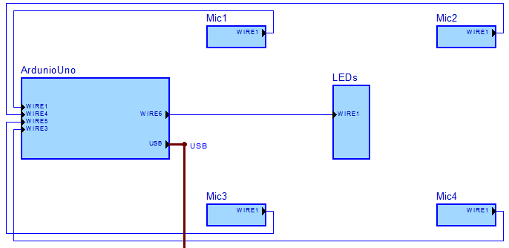
Setup
1 x Arduino Uno
1 x USB A – USB B cable
4 x 22112 microphone modules
4 x LEDs, together with resistors
1 x breadboard for prototyping
jumper wires
a computer for the programming of the Arduino board

Slide 4


Prerequisites
Arduino IDE
Matlab for computation and demonstration
Calibration process of the microphones

Slide 5
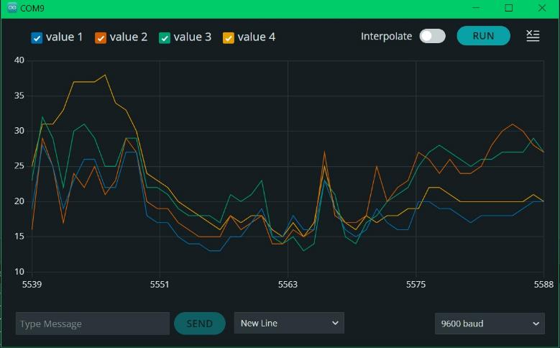
The approach
emit a sound anywhere on the grid
obtain live feed about the sound intensities of the 4 microphones
assume the highest value represents the sound source (the LED associated with the microphone lights up)

Slide 6
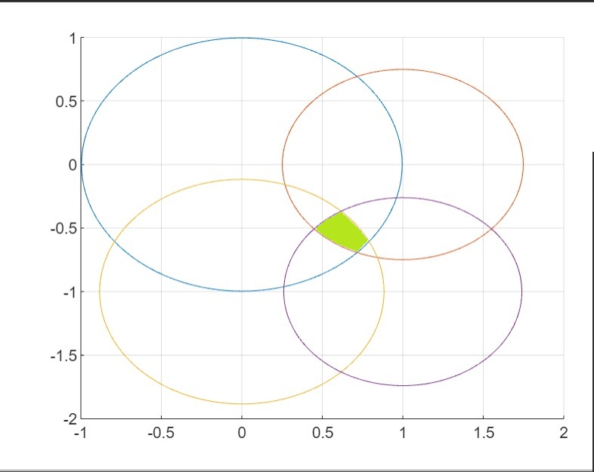


The approach
calculate the distance between the source and the sensors
scale down the results until the smallest probable nonzero area for the location of the sound source is found
display a simplified map containing the results
$$I = \frac{P_{s}}{ 4 πd^{2} }$$
Sound source location

Slide 7
Applications
Sound source separation
Sonar (navigation and ranging using sound waves)
Wildlife localization
Gunshot detection
3D sound localization applied in robotic hearing

Slide 8

Further development
Further development
Better performing hardware
An uninterrupted process
Positioning microphones further away

Slide 9
Thank you for your attention!

